Slide 1
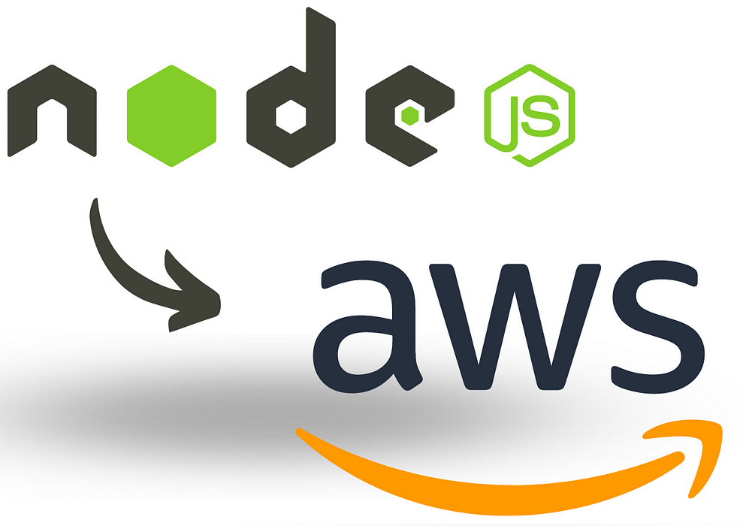
EXPRESS – CLOUD: STREAMLINED FILE MANAGEMENT PROJECT

Slide 2
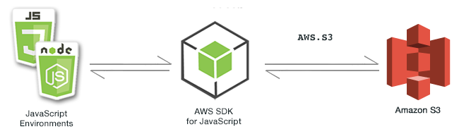
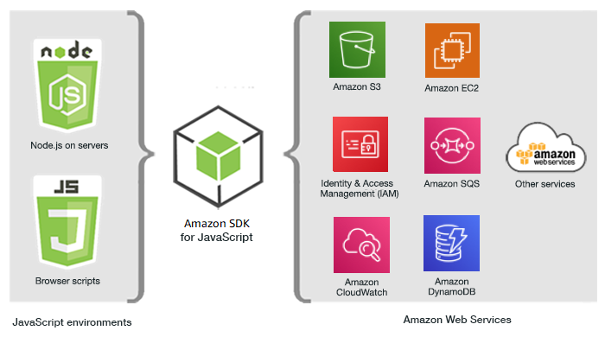
ARCHITECTURE :

Slide 3
Abstract
The project is a comprehensive web application that leverages the power of Express.js and Amazon S3 to offer a robust solution for user management and file storage. The primary objective of this application is to facilitate seamless user registration, authentication, and efficient file management operations, including upload, listing, downloading, and deletion of files.
This project is also a web application designed to manage user registration, authentication, and file operations using Express.js and Amazon S3. Users can register, log in, upload files, list their files, download specific files, and delete files. The backend uses Node.js and Express.js for server-side logic, MongoDB for user data storage, and AWS S3 for scalable file storage. Security is ensured through bcrypt for password hashing and environment variables for configuration. The application employs multer for efficient file handling and AWS SDK for seamless S3 integration, providing a robust solution for secure and efficient file management.

Slide 4


Where and How this project can be useful?
Business Document Management:
Companies can use your system to securely store and access business documents such as contracts, reports, and presentations. Employees across different locations can easily collaborate and retrieve necessary files as needed.
Educational Platforms:
Educational institutions can utilize your project to manage and distribute course materials, assignments, and resources to students and faculty members. It ensures easy access to educational content from anywhere, promoting remote learning and collaboration.

Slide 5


Media and Entertainment Industry:
Media production teams can upload and share multimedia files such as videos, images, and audio recordings. This facilitates efficient collaboration among team members and external stakeholders like clients and partners.
Healthcare Records Management:
Healthcare providers can securely store and manage patient records, medical images, and other sensitive information. This ensures compliance with data protection regulations while allowing authorized personnel to access patient data whenever necessary.

Slide 6
Advantages
Scalability and Performance :The integration with AWS S3 ensures exceptional scalability and performance. S3 is designed to handle virtually unlimited concurrent connections and massive amounts of data, making it ideal for applications that require seamless scalability as user numbers and file sizes grow.
Robust Security Features : Security is paramount in any file management application, and leveraging AWS S3 enhances this aspect significantly. AWS provides a range of security features such as encryption at rest and in transit, access control via AWS Identity and Access Management (IAM), and audit logging through AWS CloudTrail.
Reliability and Durability : AWS S3 offers unmatched reliability and durability for stored data. It is designed to provide 99.999999999% (11 nines) durability by automatically replicating data across multiple devices and facilities within a region.
Seamless Integration and Ecosystem : The project's architecture, built on Node.js and Express.js, seamlessly integrates with AWS S3 through the AWS SDK for JavaScript. This integration allows developers to leverage AWS's extensive ecosystem of services.
Cost-Effectiveness and Efficiency : By using AWS S3, the project benefits from a pay-as-you-go pricing model, where users only pay for the storage and bandwidth they actually use.

Slide 7
Project uses in Legal and Financial services:
Secure Document Storage: Law firms and financial institutions can securely store sensitive documents and ensure compliance with data protection regulations.
Client File Management: Lawyers and financial advisors can manage client files efficiently, ensuring quick access when needed.
Contract and Agreement Storage: Important contracts and agreements can be securely stored and accessed as required.
Data Encryption: Ensures that sensitive client information is encrypted both in transit and at rest, maintaining confidentiality.
Compliance: Helps law firms comply with data protection regulations such as GDPR, HIPAA, and others by providing secure storage solutions.

Slide 8
How we plan to improve this project
Load Balancing: Implement advanced load balancing techniques to ensure consistent performance and reliability, even during peak usage times.
Customization Options: Allow users to customize their interface according to their preferences for a more personalized experience.
Intuitive Dashboard: Redesign the user dashboard to make navigation more intuitive and user-friendly.
Mobile and Offline Capabilities: The project aims to develop mobile applications that synchronize seamlessly with the web platform, enabling users to manage files offline and ensuring consistent access across devices.
Machine Learning and AI Integration: Leveraging AWS AI/ML services such as Amazon Rekognition and Amazon Textract to automate file tagging, content analysis, and document management, enhancing productivity and efficiency.
Community and Collaboration Features: Introducing collaborative tools like file versioning, comments, and integrations with third-party productivity tools (e.g., Slack, Microsoft Teams) to foster seamless project collaboration and improve team workflows.

Slide 9
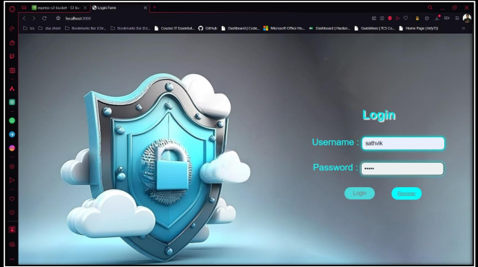
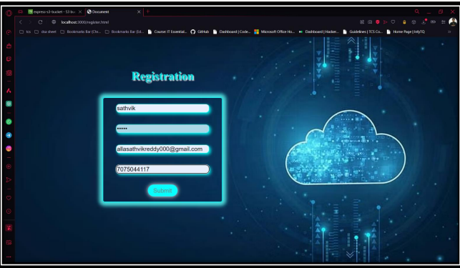
OUTPUTS :
LOGIN PAGE : The login page provides a secure interface for existing users to authenticate with their credentials. It verifies username and password against stored records in MongoDB, ensuring secure access to the application.
Register Page: Users access the register page to create new accounts. They input username, password, email, and mobile number. Upon submission, bcrypt hashes the password and stores user data securely in MongoDB for future authentication.

Slide 10
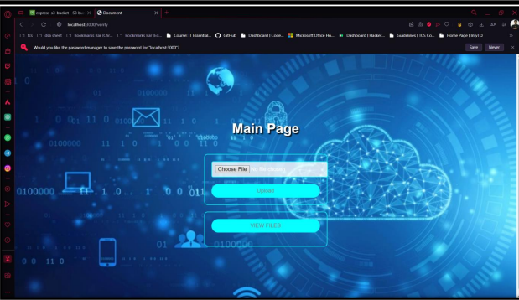
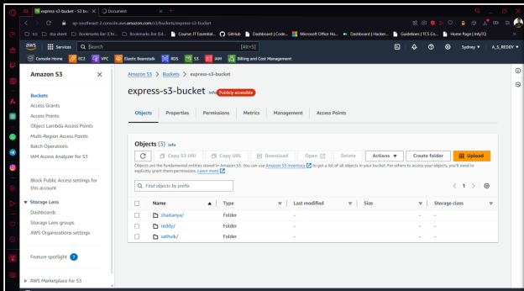
Main Page: This is the main dashboard where authenticated users land post-login. It displays options like uploading files to AWS S3, viewing uploaded files, and managing user profile settings. It acts as the central hub for user interaction and file management tasks.
AWS S3 Page: The AWS S3 page allows users to interact with their stored files. They can download specific files from their designated S3 bucket, managed securely with folder-based organization. This page integrates AWS SDK commands for seamless file operations and ensures reliable storage management.

Slide 11



